Slide 1

YOUTUBE SONG ANALYSIS
BY – Ashish Nishad
Batch Name: MIP-DA-10
Profile: Data Analyst Intern

Slide 2
Project overview and objective: - This project aims to analyze YouTube song data using Power BI comprehensively. - The dataset contains key attributes such as video ID, channel title, title, description, tags, published date, view count, like count, favorite count, comment count, video duration, video definition, and caption details. - The goal is to utilize Power BI to create insightful visualizations and reports that provide a deeper understanding of YouTube songs' performance, popularity, and user engagement. - The analysis aims to cover trends, preferences, and patterns in the data to aid content creators and stakeholders in optimizing their YouTube song content.

Slide 3
Data collection and data cleaning
Data imported to Power BI desktop.
Data cleaning:
Managing and eliminating null values from the Data set.
Removing redundant columns.
Formatting columns order-wise.
Creating new columns

Slide 4
DATA DESCRIPTION
• video_id: Unique identifier for each YouTube video.
• channelTitle: Title of the YouTube channel publishing the song.
• title: Title of the YouTube song video.
• description: Description provided for the YouTube song video.
• tags: Tags associated with the YouTube song video.
• publishedAt: Date and time when the YouTube song video was published.
• viewCount: Number of views received by the YouTube song video.
• like count: Number of likes received by the YouTube song video.
• favoriteCount: Number of times the YouTube song video has been marked as a favorite.
• commentCount: Number of comments posted on the YouTube song video.
• Duration: Duration of the YouTube song video.
• definition: Video definition or quality (e.g., HD, SD).
• caption: Availability of captions for the YouTube song video

Slide 5
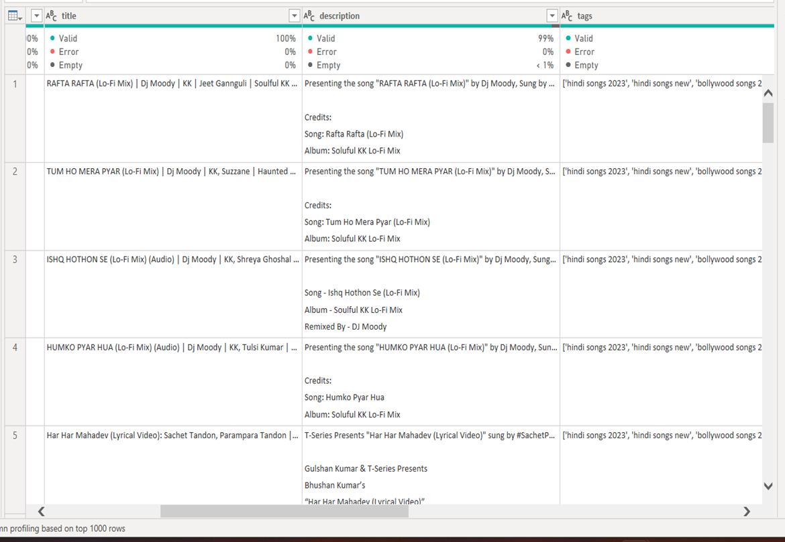
Getting null values
Getting null values

Slide 6
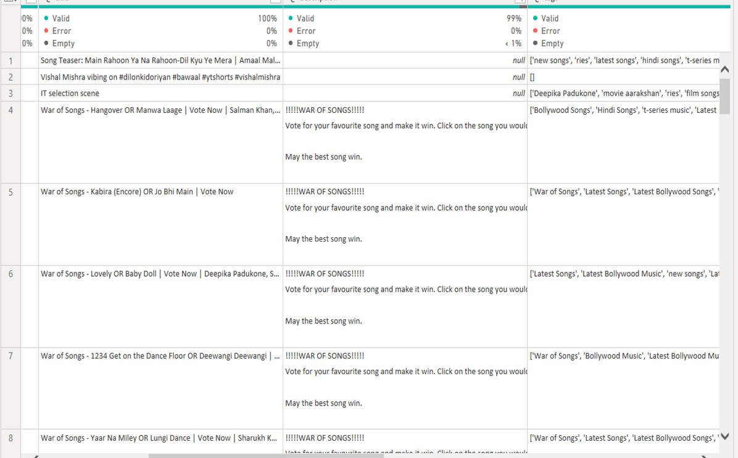
Sorting and detecting null values

Slide 7
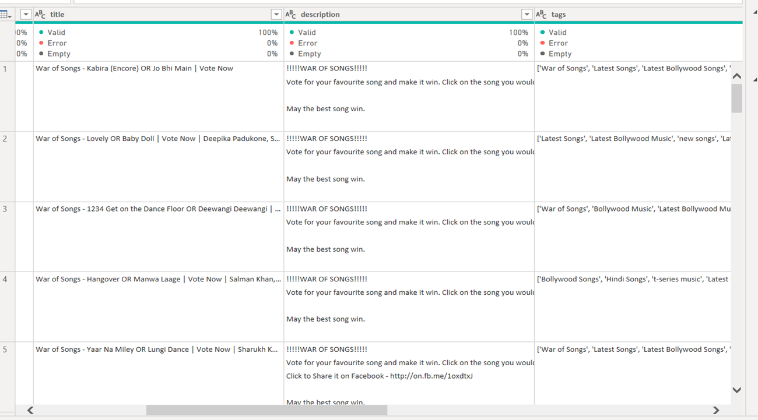
Removing null values

Slide 8
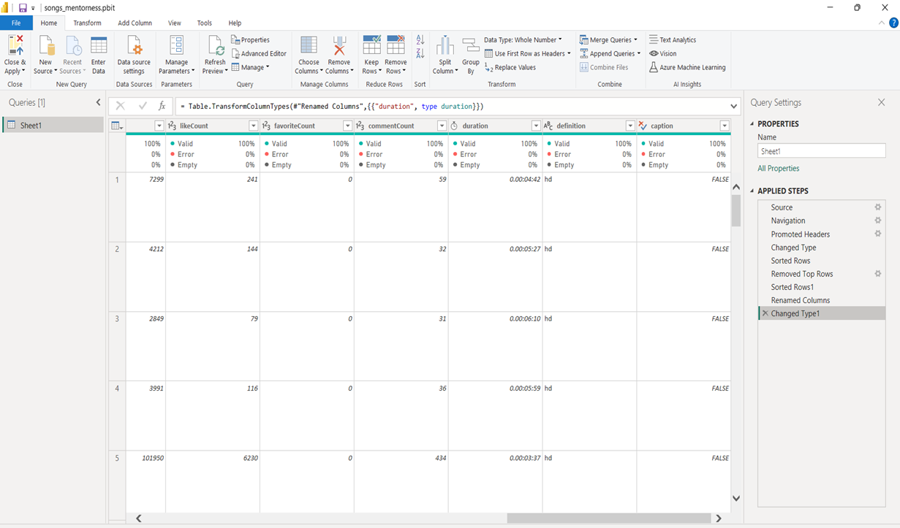
Changing and checking the data type of each column

Slide 9
1) Important KPI’s: using cards

Slide 10
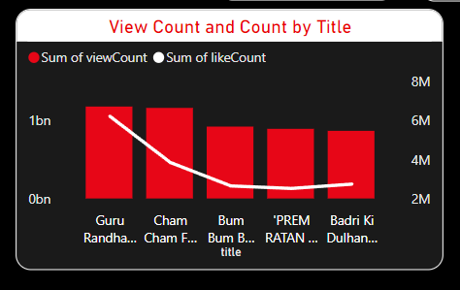
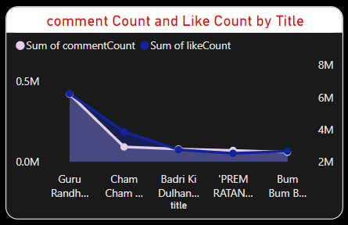
2) Exploratory Data Analysis (EDA): - explore patterns and distributions in view counts, like counts, and comments. - identify trends in the popularity and engagement of YouTube song videos.

Slide 11
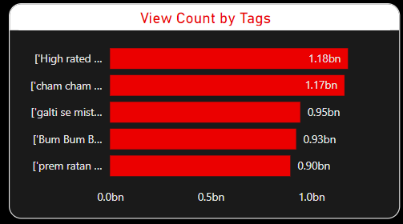
3) Content and Channel Analysis: - Analyze the distribution of videos across different channels. - Identify popular tags and their correlation with view counts.

Slide 12
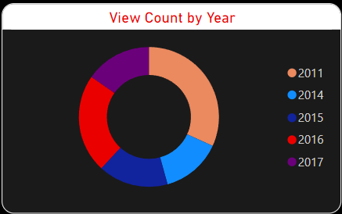
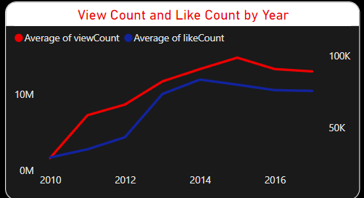
4) TEMPORAL TRENDS: - Explore how YouTube song video metrics vary over time. - Identify peak publishing times and their impact on engagement.

Slide 13
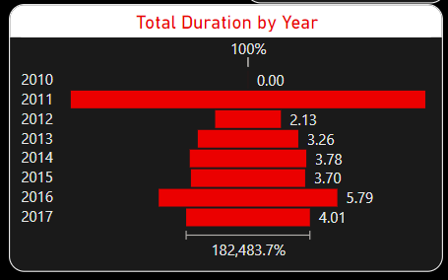
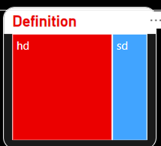

5) User Engagement Insights: - investigate relationships between likes, comments, and views. - identify factors influencing user engagement with YouTube song videos.
.
.
.
.
.
.

Slide 14
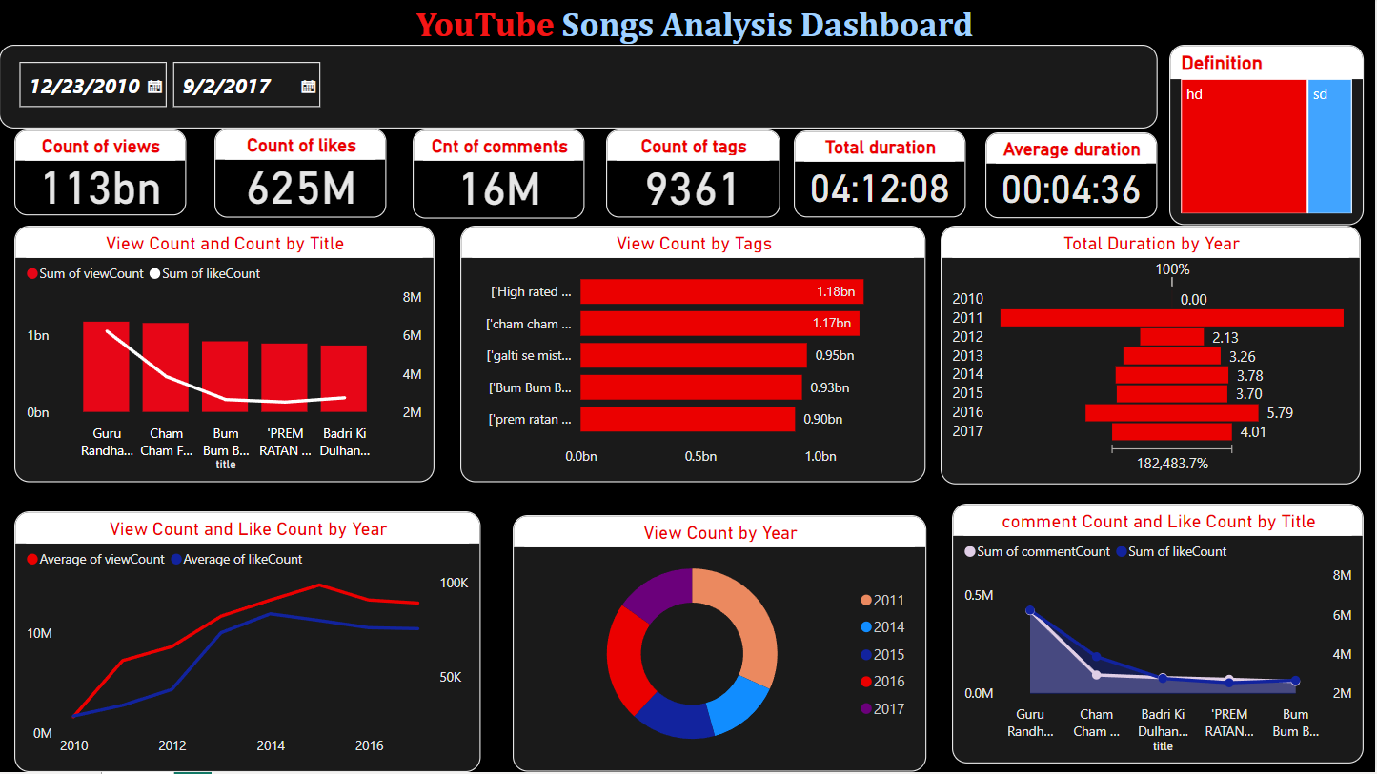
Final dashboard

Slide 15
Conclusion:
Design attractive thumbnails.
Partner with other content creators.
Promote videos on social media platforms.
The Definition of video greatly affects engagement in watching videos. Now HD is more preferred as compared to SD.
Tags play an important role as far as performance is concerned. Therefore tags should be such that they easily relate to the viewer and can be found out easily when searched.
Duration of video is another factor that affects enormously on the performance of a video. Therefore, this should also be kept in mind.

Slide 16

Thank you
This Photo by Unknown Author is licensed under CC BY-SA

